Slide 1
DSC640 Weekly Assignment
Week 11 & 12
Edris Safari

Slide 2
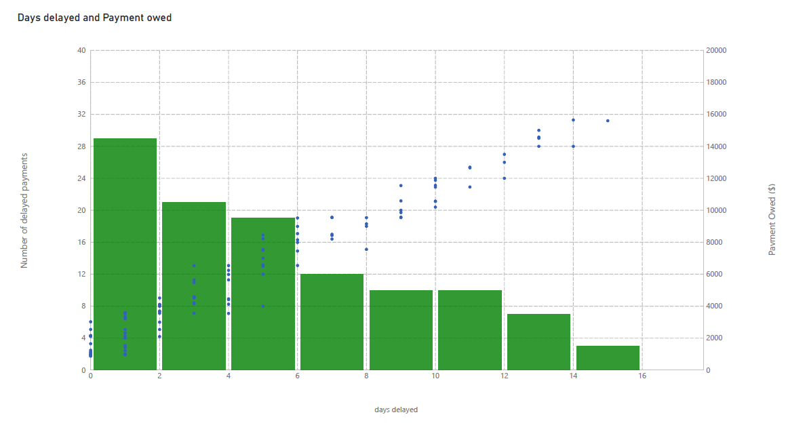
PowerBI Histogram

Slide 3
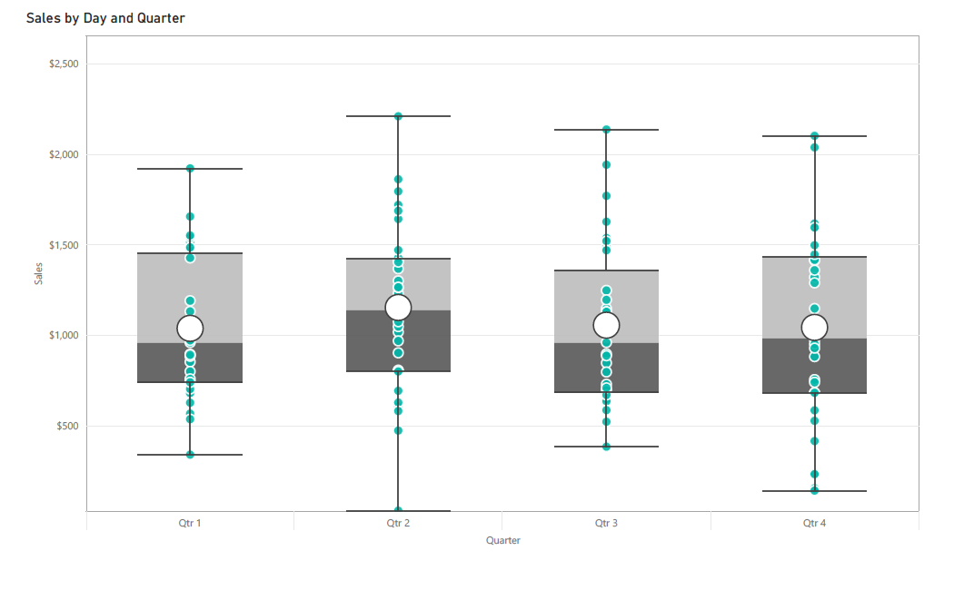
PowerBI Box Plot

Slide 4
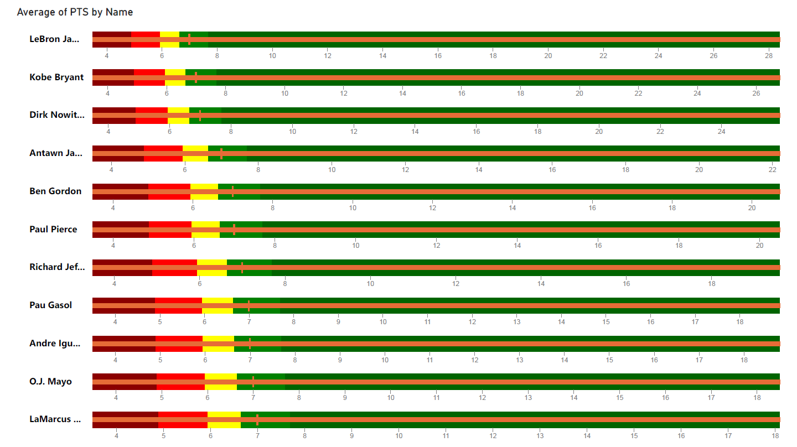

PowerBI Bullet Chart

Slide 5
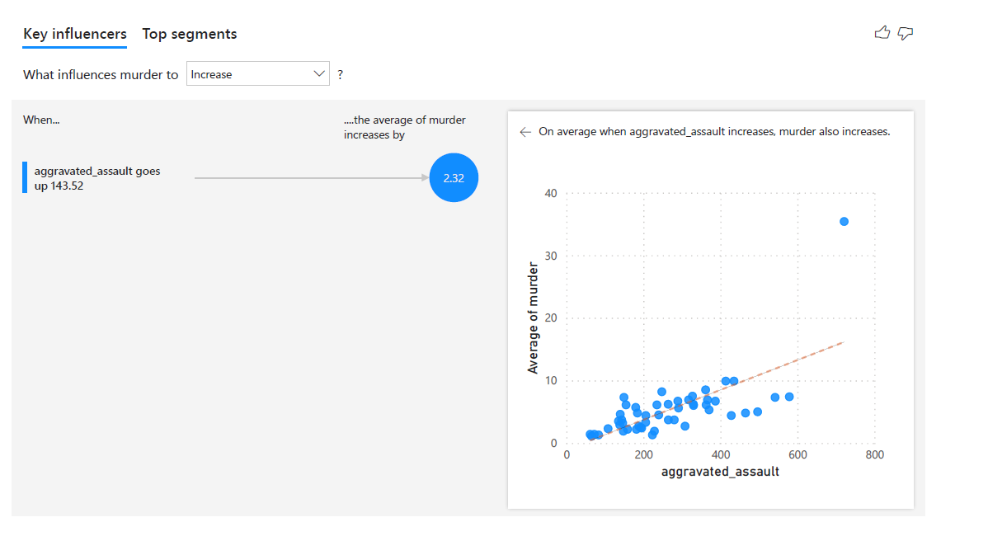
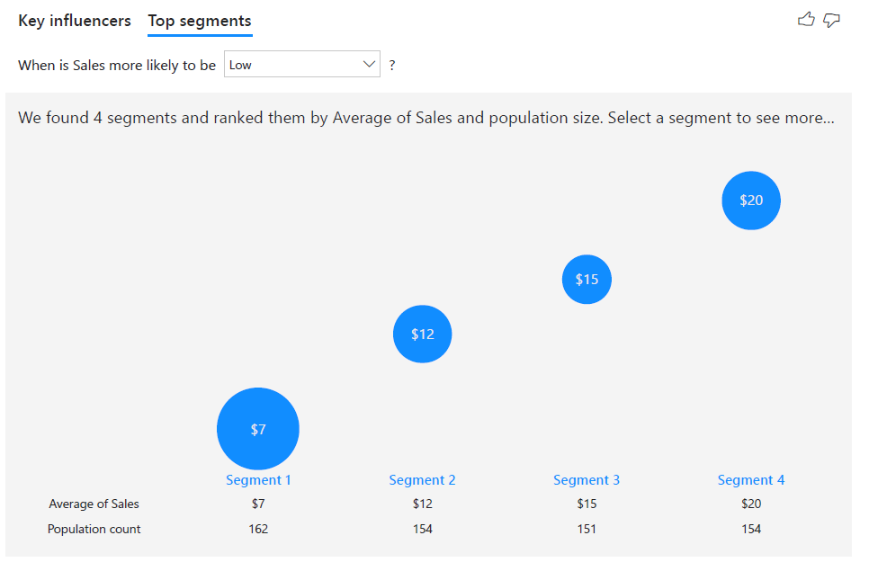
PowerBI Key Influencers Chart

Slide 6
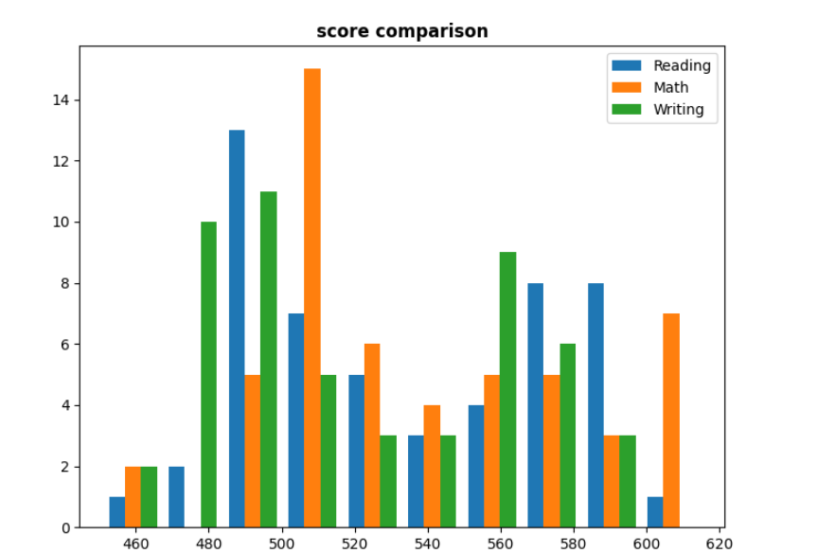
Python Histogram

Slide 7
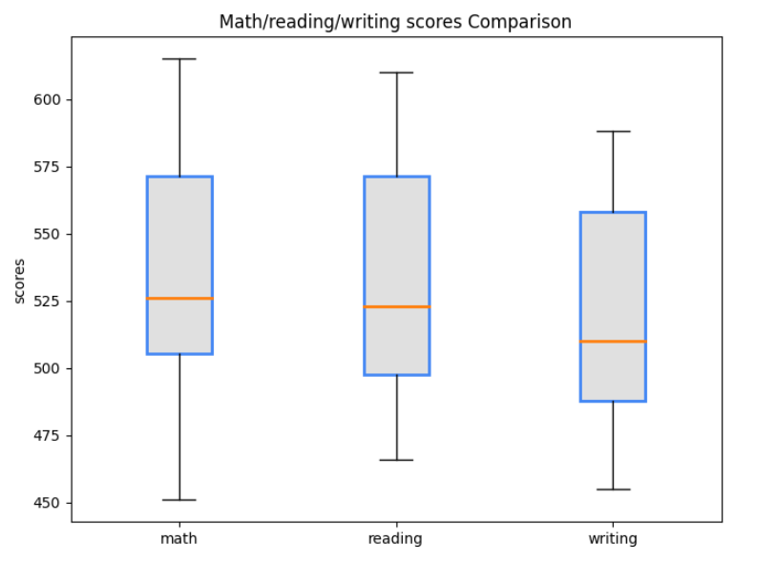
Python Box Plot

Slide 8



Python Bullet Chart

Slide 9
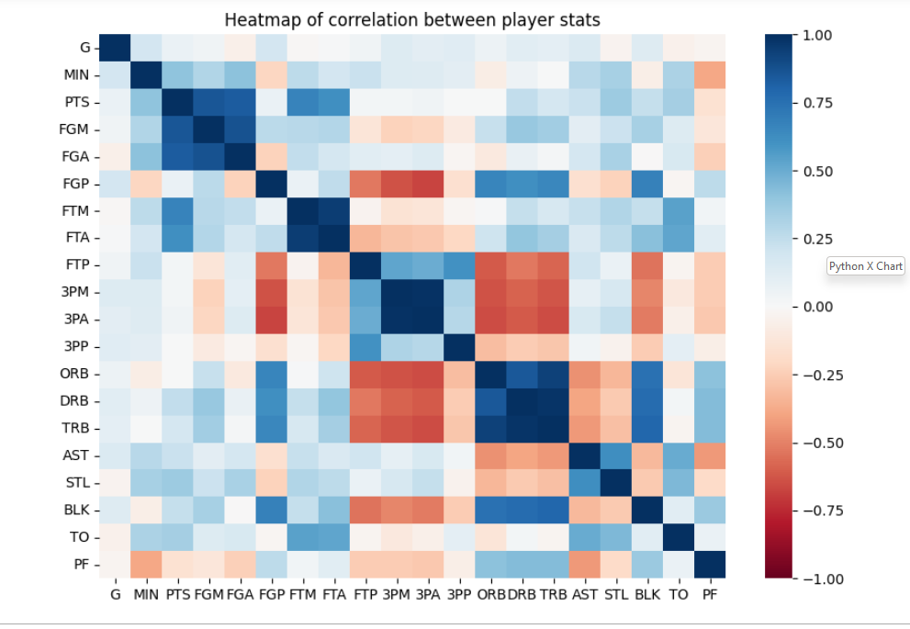
Python Heatmap

Slide 10
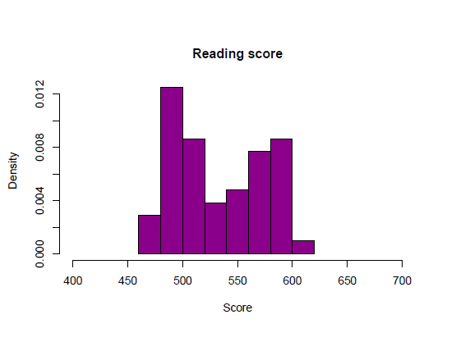
R Histogram

Slide 11
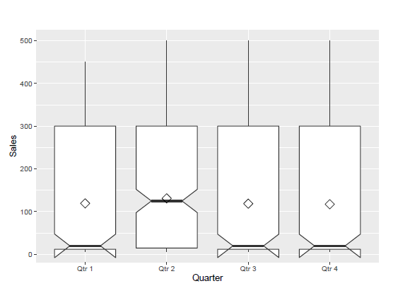
R Box Plot

Slide 12
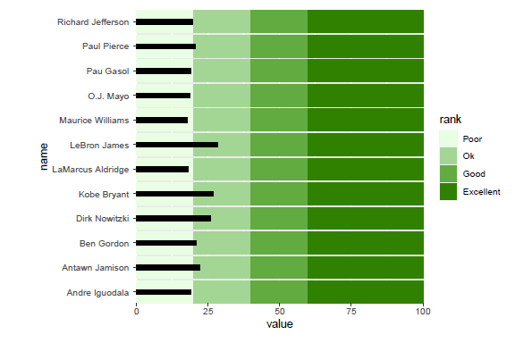
R Bullet Chart

Slide 13
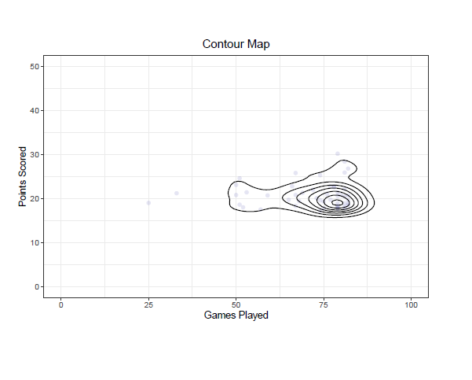
R Contour Map

